Slide 1
Windows
Installation
Hands-on Part A

Slide 2
Installing Git on Windows
#1 Install Windows Subsystem for Linux (WSL)
#2 Configure WSL
#3 Configure Git
Ubuntu 18.04 LTS
github.com/hangxingliu/wslgit
git clone git@github.com:user/a.git

Slide 3
WSL's Required Environment
WSL
Start button
> Settings
> Update & Security
> Windows Update
Be sure to update your Windows OS
Must be Windows 10 Version 1709 (OS build 16299) or later!

Slide 4
Install Windows Subsystem for Linux (WSL)
WSL
Enable-WindowsOptionalFeature -Online -FeatureName Microsoft-Windows-Subsystem-Linux
Enable "Windows Subsystem for Linux" optional feature
Open PowerShell as Administrator and run the command
Restart your computer when prompted.
Notes:
https://docs.microsoft.com/en-us/windows/wsl/install-win10#complete-initialization-of-your-distro
https://docs.microsoft.com/ja-jp/windows/wsl/install-win10

Slide 5
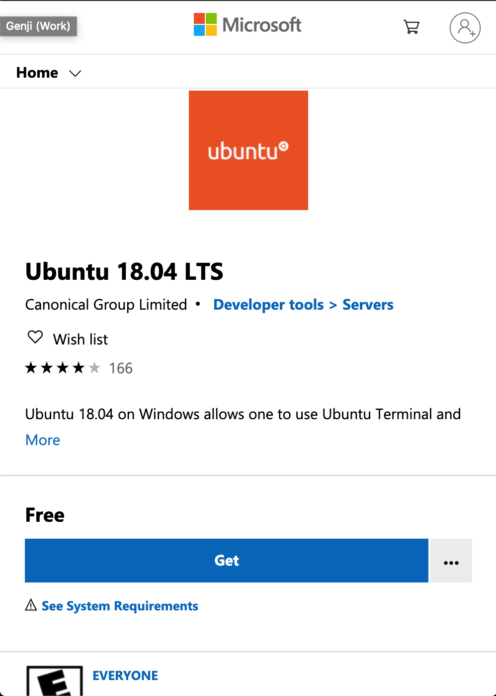
Install Windows Subsystem for Linux (WSL)
WSL
Install your Linux Distribution of Choice
Download and install from the Microsoft Store (see below)
Ubuntu 18.04 LTS
microsoft.com/store/apps/9N9TNGVNDL3Q
Notes:
https://docs.microsoft.com/en-us/windows/wsl/install-win10#complete-initialization-of-your-distro
https://docs.microsoft.com/ja-jp/windows/wsl/install-win10

Slide 6
Configure WSL - Initialize
WSL
, this may take a few minutes...
Please create a default UNIX user account. The username does not need to match your Windows username.
For more information visit: https://aka.ms/wslusers
Enter new UNIX username: panda
Enter new UNIX password:
Retype new UNIX password:
passwd: password updated successfully
Installation successful!
To run a command as administrator (user "root"), use "sudo <command>".
See "man sudo_root" for details.
Launch the distro (Ubuntu 18.04)
Click the launch button in the Microsoft Store App
Setting up a new Linux user account
This user account will not impact your Windows username
The password is needed when running sudo commands
Notes:
https://docs.microsoft.com/en-us/windows/wsl/initialize-distro
https://docs.microsoft.com/ja-jp/windows/wsl/initialize-distro

Slide 7
Configure WSL - Initialize
WSL + Git
Update & upgrade your distro's packages
Enter Y when asked "Do you want to continue? [Y/n]"
Install git
sudo apt update && sudo apt upgrade
sudo apt install git
Notes:
https://docs.microsoft.com/en-us/windows/wsl/initialize-distro
https://docs.microsoft.com/ja-jp/windows/wsl/initialize-distro

Slide 8
Configure WSL - Initialize
WSL + Git
Download the wslgit repository
tool to forward all requests for git to WSL
Go inside the wslgit folder
Move the wslgit.sh file to the WSL executable location in /usr/bin
Get back to home folder
$ git clone https://github.com/hangxingliu/wslgit
$ cd wslgit/
$ sudo mv wslgit.sh /usr/bin/wslgit.sh
$ cd

Slide 9

Configure WSL - VS Code
WSL + Git + VS Code
Download Remote - WSL VS Code Extension
https://marketplace.visualstudio.com/items?itemName=ms-vscode-remote.remote-wsl
Go to VS Code Settings to change the git.path object:
{
"git.path": "C:\Users\Please\AppData\Local\Packages\CanonicalGroupLimited.Ubuntu18.04onWindows_79rhkp1fndgsc\LocalState\rootfs\home\panda\wslgit\git.bat"
}
Notes:
https://git-scm.com/book/en/v2/Getting-Started-Installing-Git

Slide 10
Japanese version of Ubuntu
JP + Ubuntu
sudo apt -y install language-pack-ja
sudo update-locale LANG=ja_JP.UTF8
sudo apt -y install manpages-ja manpages-ja-dev
Install the Japanese language pack
Set local language to Japanese
Restart Ubuntu
Install Japanese manuals
Notes:
https://qiita.com/asazuke/items/f8eff69bce0bee083fcf#writing_hand_tone2wsl%E7%92%B0%E5%A2%83%E6%A7%8B%E7%AF%89%E5%80%8B%E4%BA%BA%E7%9A%84%E3%83%A1%E3%83%A2writing_hand_tone2

Slide 11
Configure Git + GitHub
Git + GitHub
$ ssh-keygen
Generating public/private rsa key pair.
Enter file in which to save the key (/home/user/.ssh/id_rsa):
Created directory '/home/user/.ssh'.
Enter passphrase (empty for no passphrase):
Enter same passphrase again:
Your identification has been saved in /home/user/.ssh/id_rsa.
Your public key has been saved in /home/user/.ssh/id_rsa.pub.
…
Generate an SSH key
It is required to link with GitHub
Leave the questions blank and just ENTER

Slide 12
Configure Git + GitHub
Git + GitHub
Copy the key to the clipboard
This is needed to be pasted into GitHub.com's setting page.
cat ~/.ssh/id_rsa.pub | clip.exe

Slide 13
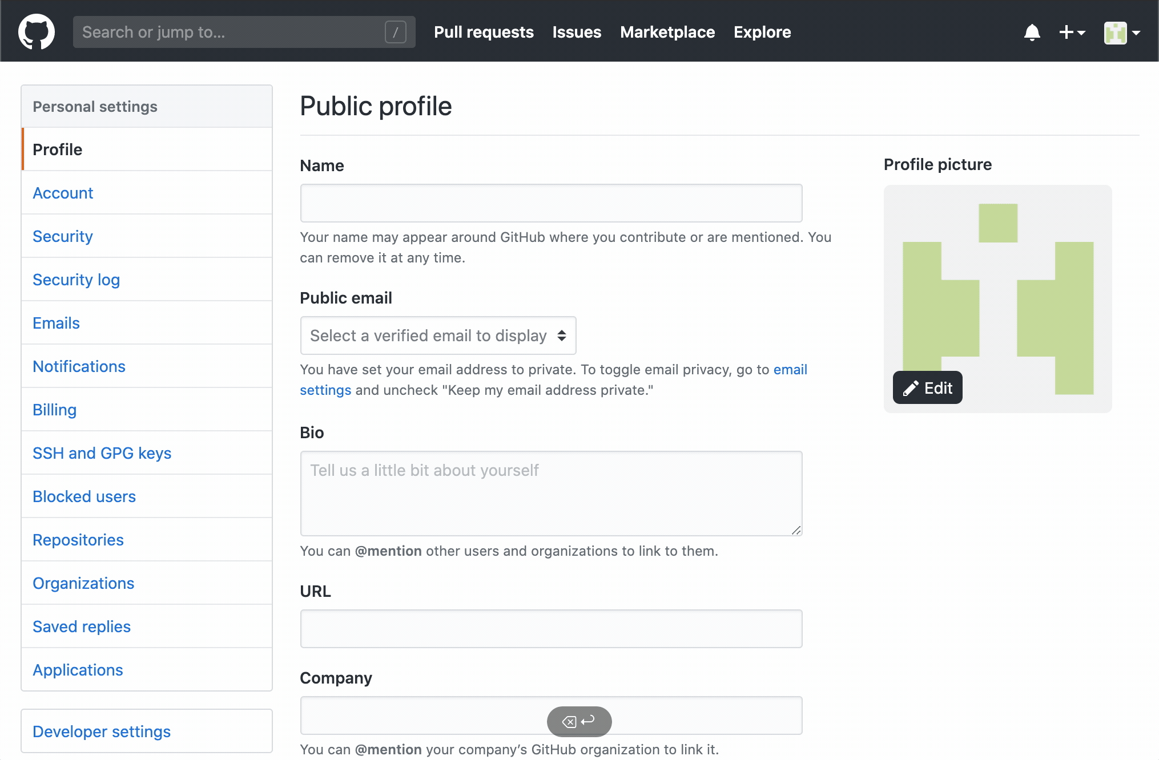
Configure Git + GitHub
Git + GitHub
GitHub.com/settings
> SSH and GPG Keys
> click New SSH key button
Type Windows WSL for Title
Paste the public key
> click Add SSH key button

Slide 14
Confirm the Settings
Git + GitHub
Confirm the settings with the following commands
$ ssh -T git@github.com
The authenticity of host 'github.com (13.114.40.48)' can't be established.
RSA key fingerprint is SHA256:xxx.
Are you sure you want to continue connecting (yes/no)? yes
Warning: Permanently added 'github.com,13.114.40.48' (RSA) to the list of known hosts.
Hi ahandsel! You've successfully authenticated, but GitHub does not provide shell access.

Slide 15
VS Code + Explorer
WSL
To open the Explorer from the current Linux folder, enter:
To open the VS Code from the current Linux folder, enter:
explorer.exe .
code .
Notes:
https://docs.microsoft.com/en-us/windows/wsl/initialize-distro
https://docs.microsoft.com/ja-jp/windows/wsl/initialize-distro

Slide 16
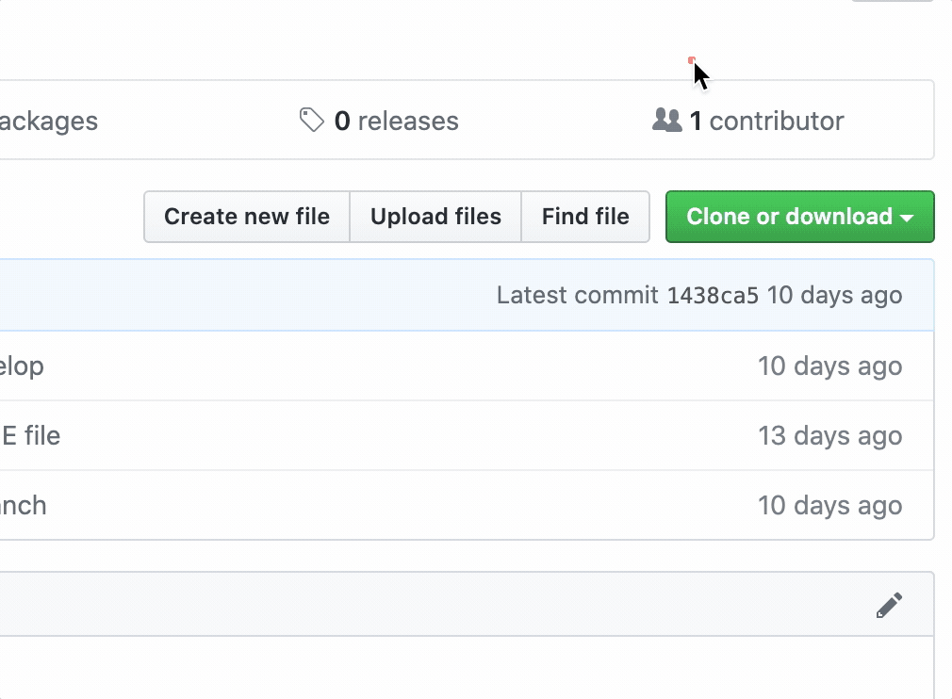
Windows + WLS and GitHub
WSL + GitHub
Instead of using HTTPS → Use SSH
git clone https://github.com/.../a.git
git clone git@github.com:.../a.git

